Slide 1
VMware Aria Operations
(Formerly, vRealize Operations)
Customer Overview
Notes:
Click to add notes

Slide 2
Challenges with Operations Management
Includes optimizing processes and ensuring staff availability & skills
Meet SLAs
Modernize
Visibility
Manage Costs
Manage Risk
Deliver performance to meet business needs
Better use existing resources
Troubleshoot to make quick decisions
Licensing, CAPEX, OPEX
Stay compliant and secure
Notes:
Customers tell us that they have several challenges with operations management, and I’ll walk you through a few of them.
With operations management it can be complex and sometimes silo’d, and customers say they need to:
Meet SLAs - Struggling to deliver performance at minimal costs, to meet business needs
Modernize - Spinning up a new datacenter, or have consolidation & modernization projects - and need to better use existing resources
Unified Visibility - Deploying SDDC technologies or integrating public clouds, and struggling to get unified visibility for troubleshooting to make quick decisions
Cut Costs - Looking at ways to cut costs because they continue to rise as more applications are built on containers. While this better enables developer agility, the visibility and management can be difficult. Here’s a fun fact = 86% of those surveyed said they expect containers, microservices, and Kubernetes to have significant impact on their multi-cloud management strategy in the coming years.
Manage Risk - Want to manage risk and stay compliant while assuring performance
TRANSITION: VMware can help ease your organization’s journey to cloud – wherever you are in your journey (private, moving to hybrid or multi-cloud) with VMware Aria Operations™.

Slide 3

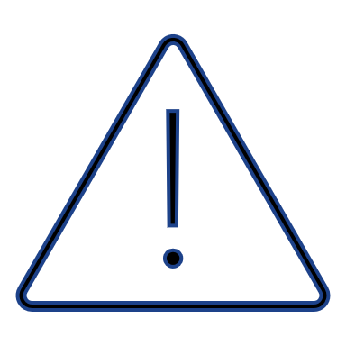
Building Your Pathway to Unparalleled Operations
Intelligent & Automated
You have developed trust for your system and feel comfortable allowing it to make fixes for you.
Predictive & Proactive
Your system tells you something is going to go wrong, and you can spend time working on expected issues.
Reactive & Manual
You are manually remediating and restoring issues that you didn’t see coming.
Notes:
We see three phases that our customers typically go through in their operations management journey.
It starts with the customer who is always manually putting out fires because they don’t have the data depth or context they need to understand what’s going on in their environment. We often see this happen with customers who aren’t using management tools or have basic, out of the box tools that don’t have contextual visibility. Without implementing a solution for consistent Multi-Cloud Operations, customers will have no chance to take control. Don’t get me
In the second phase, the customer has started to utilize their operations management platform in a way that it can alert them when something is expected to go wrong and fix it before it becomes a problem.
In the third phase you’ll see customers who have developed trust with their system, and they are using automation to fix issues based on the AI/ML platform.

Slide 4

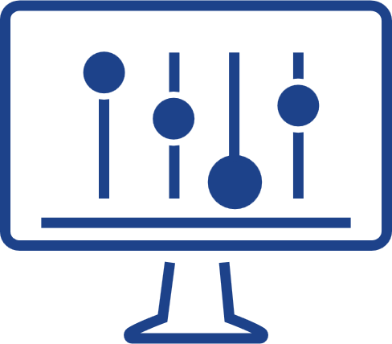

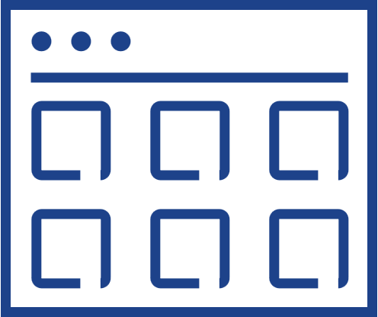
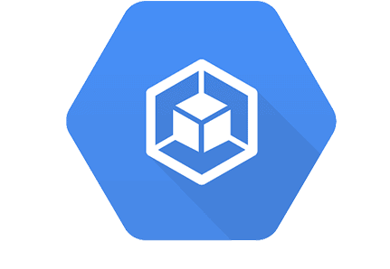
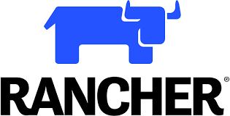
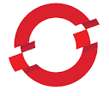
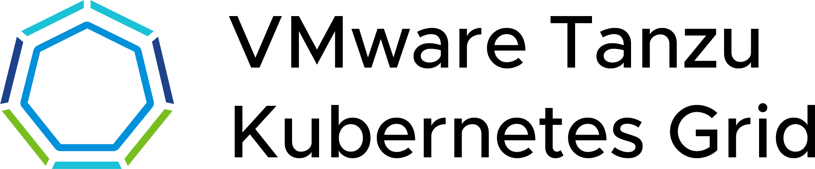
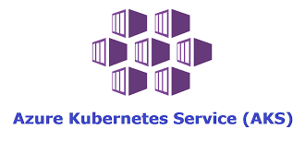
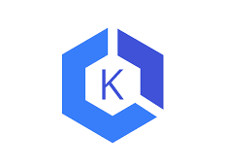

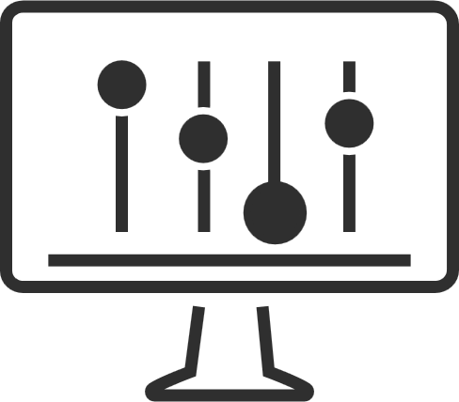

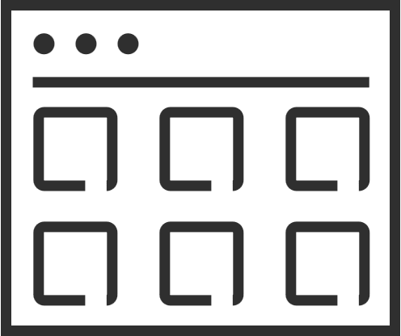
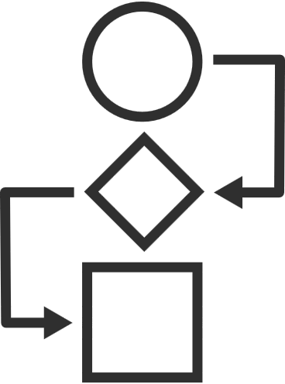





What does good look like?
The Cloud Operating Model
App strategy
Retain
Rehost
Replatform
Refactor
Retire
CLOUD OPERATING MODEL
2. MANAGE ACROSS CLOUDS
VMware multi-cloud management
Cost
Performance
Secure Config
Delivery
Kubernetes runtime and management
1. BUILD CLOUDS
VMware Cloud
Public Cloud
Cost
Performance
Secure Config
Delivery
Cost
Performance
Secure Config
Delivery
IAAS CAAS PAAS
IAAS CAAS PAAS
VMware multi-cloud management
PRIVATE CLOUDS
PARTNER CLOUDS
SOVEREIGN CLOUDS
TELCO CLOUDS
EDGE CLOUDS
EDGE
VMware infrastructure
Notes:
This is how you achieve success in the multi-cloud transformation
App Strategy
All customers have an app strategy for both new and existing applications.
As they look to rationalize and modernize their application portfolios, they need to decide whether to retain, rehost, replatform, refactor or even retire them, possibly replacing them with SaaS versions.
It's always a combination – you have traditional Apps, Kubernetes-based apps, cloud native apps, SAS-based apps – across the board.
Development team needs to make decisions on where to deploy new apps and whether to migrate existing ones these apps on different clouds, whether native public clouds or VMware-based clouds.
To do this right, they need an effective, efficient method of managing their multi-cloud world, one that supports their application and business objectives.
This involves not just using the right cloud management technology but implementing it in the broader context of the right people and process as well.
VMware’s Cloud Operating Model can help with this.
So what is a cloud operating model?
Public Cloud
In the case of the native public clouds, developers can directly consume the services they require.
The native public clouds provide an interface where developers can go and consume the various IaaS and PaaS services in a self-service way.
They’ve got infrastructure as code with things like AWS Cloud Formation templates.
They’ve got Cloud Watch and Cloud Trail in AWS that provide performance, logs and metrics, as well as cost APIs and security APIs.
VMware Cloud
In the case of VMware Cloud environments what we have to do is convert them into the experience of a native public cloud
That's where VMware Aria Management comes in.
Infrastructure and Cloud Operations team first have to set up the cloud constructs.
Second, they have to set up the set of services that they want to deliver.
They deploy their database as a service, their IaaS services, they curate their image sizes and flavors and define their availability zones.
Once they have curated the services, they then manage the cost of applying capacity, performance and security to this cloud.
So, the combination of VMC on AWS, VMware Cloud Foundation or Project Dimension and the VMware Aria cloud management capabilities makes a VMware Cloud.
It delivers the same set of self-service IaaS, performance, cost and security APIs to the developer, so now the developers can directly consume from VMware Cloud.
Multi-cloud and Kubernetes Management
We can also extend these capabilities to native public clouds by creating a common IaaS service across not just VMware Cloud but all public clouds.
And with Tanzu Mission Control we provide a common Kubernetes management platform across all VMware and native public clouds.
The question is, do we need anything else?
More organizations are delivering applications across public clouds and at the edge, and they’re increasingly using Kubernetes to manage and scale their modernized and cloud-native apps.
However, managing apps and infrastructure in a multi-cloud, especially public cloud, and multi-technology environment is complex.
Teams have to control costs, ensure performance, and manage consistent security policies across these diverse and distributed environments.
Since the developers are developing across multiple clouds, a new set of issues becomes relevant.
For example, how do I know what it costs to deploy my service in one cloud versus another?
How do I secure my clouds, and how do I define policies for security once and apply them across all clouds?
How do I look at the performance of an application that may be deployed across two or three clouds?
This is where the new capabilities of our VMware Aria offering comes in.
VMware Aria, which provides a set of end-to-end solutions for managing the cost, performance, configuration, and delivery of infrastructure and cloud native applications.
Powering VMware Aria is VMware Aria Graph, a graph-based data store technology that captures the complexity of our customers’ multi-cloud environments.
VMware Aria is uniquely positioned to address managing the cost, performance, configuration, and delivery of infrastructure and cloud native applications.
VMware Aria doesn't disintermediate the consumption of the cloud, but what it allows you to do is apply policies against that consumption.
It enables you to get visibility into cloud costs and, allows you to optimize those costs, and then later enables you to take automated decisions based on your cost characteristics.
It does the same thing with secure configuration, same thing with performance, and the same thing with delivery.
It thereby gives you a set of capabilities around financial and performance management security and delivery automation that developers can use.
So, it's taking all the set of data, synthesizing it and making it available for the developers.
This allows them to run their environment on a continuous basis and deliver the app performance, cost and security that they need.
Cloud Operating Model
This entire set of capabilities as leveraged by Infrastructure and Operations teams and the Cloud Center of Excellence is what we call the cloud operating model.
The Cloud Operating Model is a holistic story that brings people, process and technology together.
An effective Cloud Operating Model can deliver spectacular results.
Customer examples include a 25% decrease in cloud spend and a 30% increase in productivity.
The biggest root cause of problems are misconfigurations; customers who do config management right can see a 93% decrease in unplanned downtime.
Customers also enjoy a 50% reduction in software costs.
We believe we are the only vendor with capabilities that truly capture the complexity of our customer’s multi-cloud realities empowering them to handle the increasingly challenging requirements of the multi-cloud world.

Slide 5



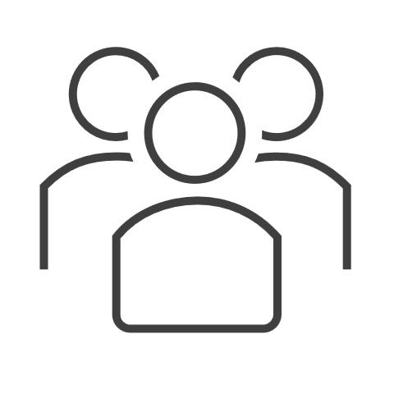
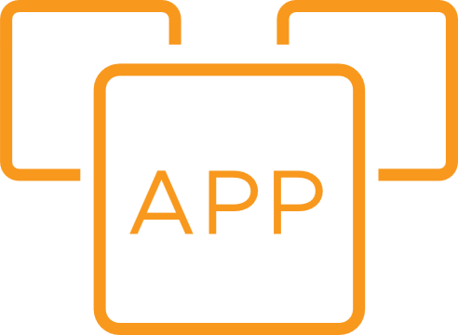
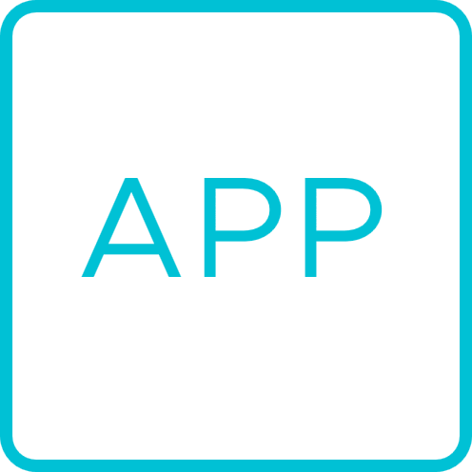
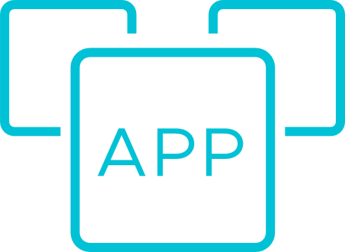

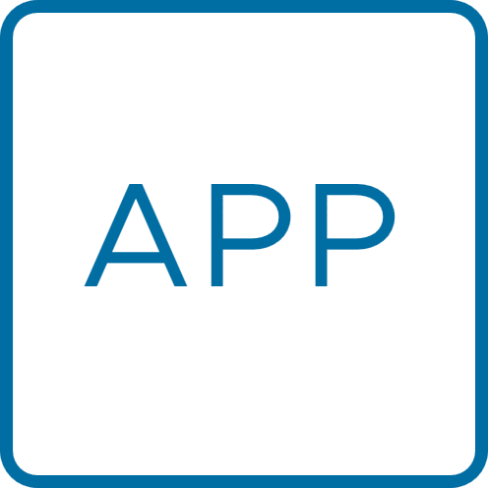
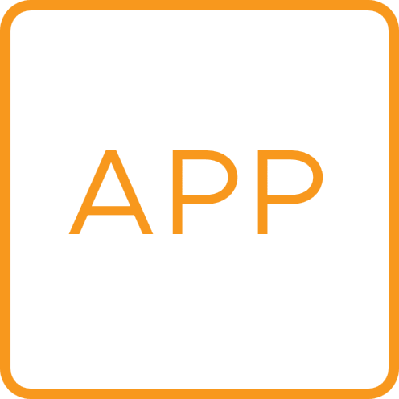
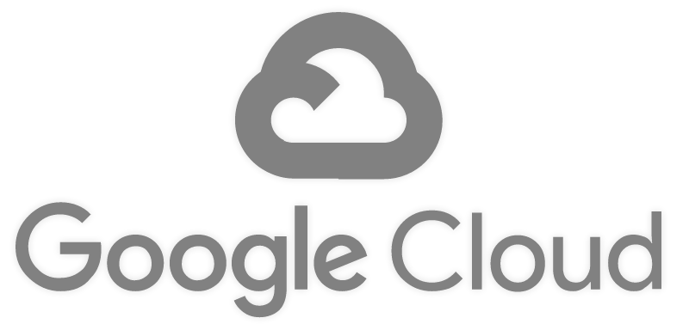
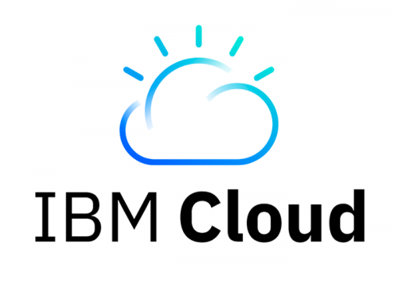
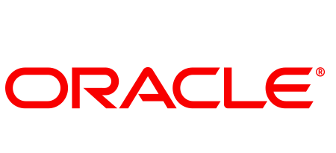
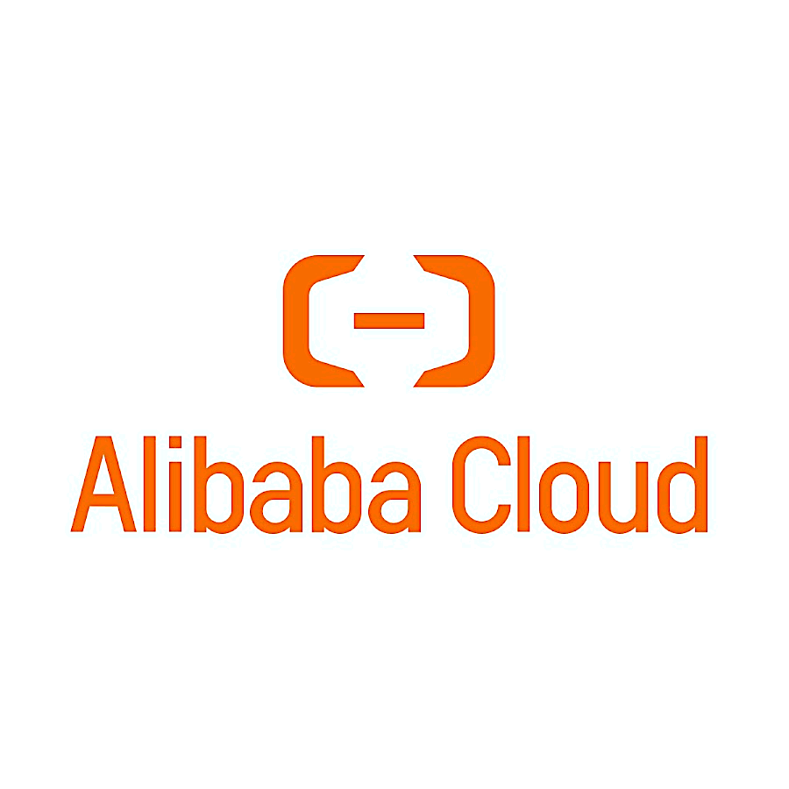
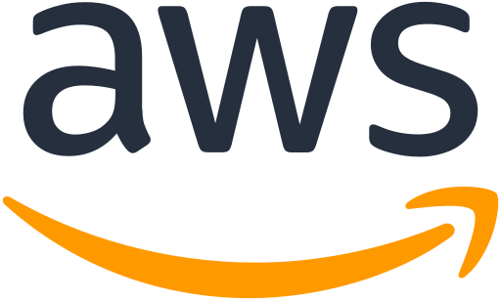

Introducing VMware Aria: a management solution for multi-cloud
VMware Aria
VMware Aria Cost
VMware Aria Operations
VMware Aria Automation
Cross-cloud cost optimization
Full stack observability
App. Monitoring
Guardrails
Regulatory config
Deliver comprehensive visibility, optimization, and governance for cost and usage across clouds
Provide full-stack visibility, troubleshooting, insights and remediation for app and infra performance
Automate and configure app and infra deployment and enforce cost, security and performance using best practices
Capacity mgmt.
Infra monitoring
Config mgmt.
Secure host config
Migration
Network mgmt.
Infra-as-code
Charge-back
Trouble-shooting
Orchestration
Log mgmt.
CI/CD
Secure cloud operations
Catalog
Common platform
VMware Aria Hub powered by VMware Aria Graph
Modern apps
PaaS
Traditional apps
SaaS
PRIVATE CLOUDS
PARTNER CLOUDS
SOVEREIGN CLOUDS
Microsoft
Azure
EDGE CLOUDS
Microsoft
Azure
TELCO CLOUDS
VMware Clouds
Public Clouds
Public Clouds

Slide 6
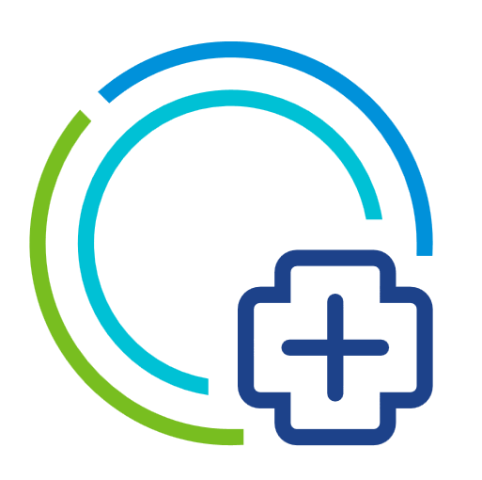
Three Vectors of VMware Aria Operations Innovation
The core to manage your multi-cloud ecosystem
AI/ML
Ecosystem Integrations
Cloud/Container
Notes:
We see three key vectors that have shaped the operations landscape and have used these to evolve and innovate VMware Aria Operations in a way that we believe will give you the platform you need to accelerate growth for your business.
First is the AI/ML engine – making it more proactive based on the intelligent data platform. Then the two big market forces that we see from the customers, which is cloud adoption and the need for more and more open ecosystem integrations.

Slide 7
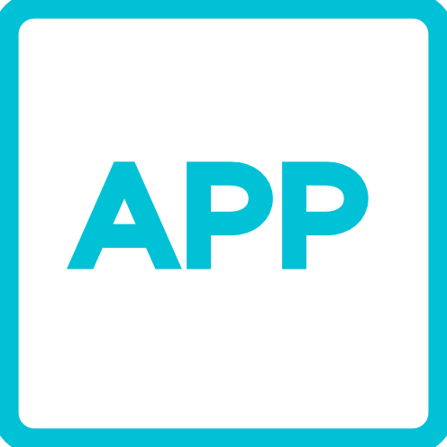
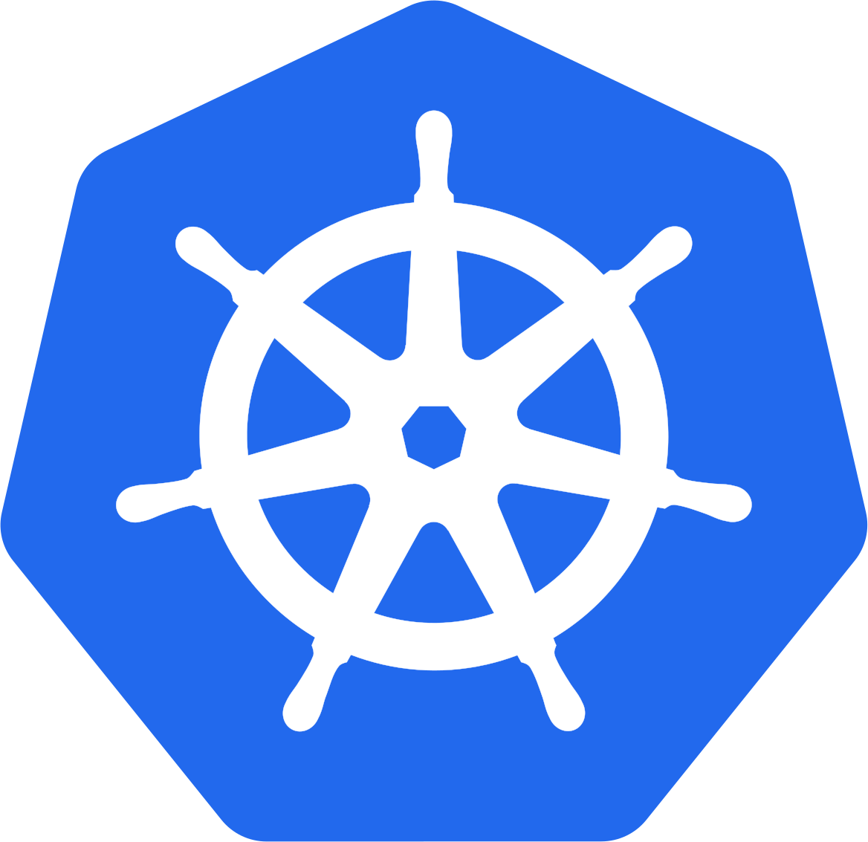
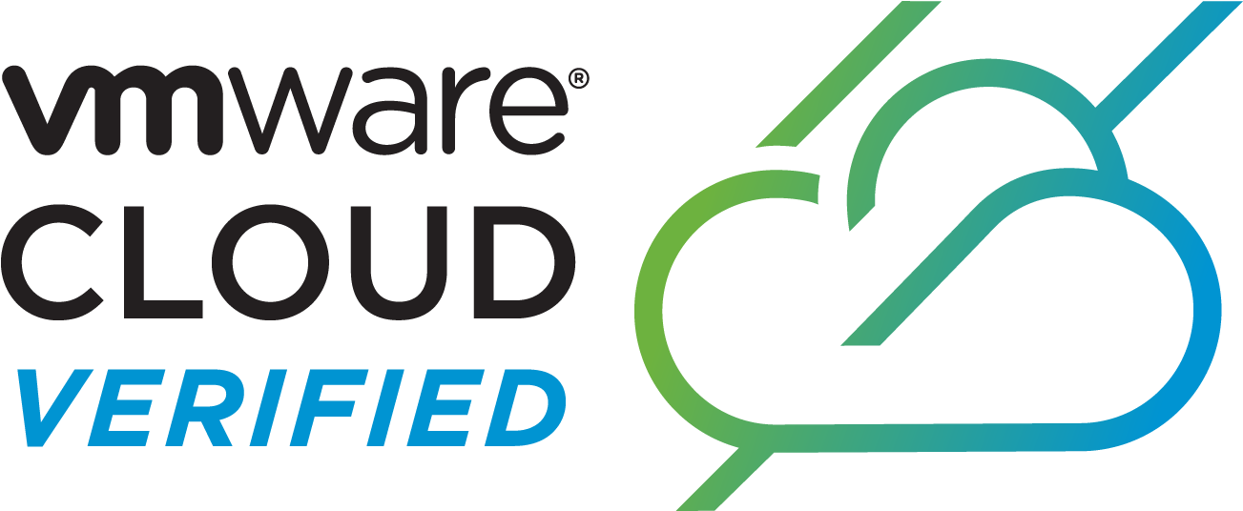
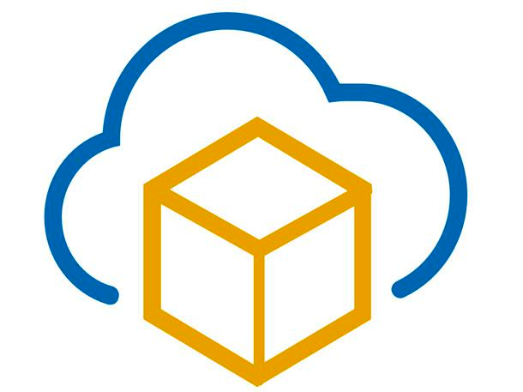
VMware Aria Operations Core Capabilities
Powered by AI, from apps to infra, across VMware Cloud on AWS
Continuous Performance Optimization
Apps
Continuous Performance Optimization
Assure performance with automatic workload placement and balancing based on business and operational intent.
VMware Cloud Foundation
Containers
Efficient Capacity & Cost Management
Run infrastructure for optimal consolidation, proactive planning, and procurement.
Public Cloud
App-Aware Intelligent Remediation
Predict, prevent, and troubleshoot across VMware Cloud and multi-clouds, from applications to infrastructure.
Edge
Unified Ops Platform
Powered by ML
Integrated Configuration & Compliance
Reduce risk and enforce IT and regulatory standards with integrated compliance and automated remediation.
Partners
VMware Cloud

Slide 8
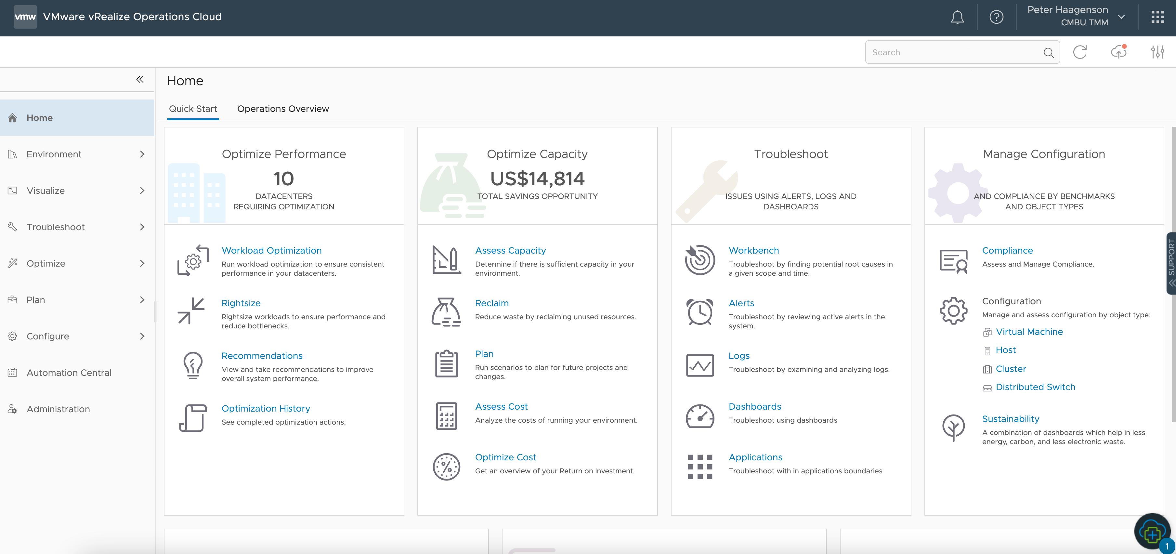
Self-Driving Operations with VMware Aria Operations

Slide 9
Show me how it works
VMware Aria Operations Demo
Notes:
Depending on the situation – go to the demo, or if there are demo issues, use the next 4 slides to talk about the pillars of vROps.

Slide 10
Intent-Driven Continuous Performance Optimization
Automated Intent-driven Workload Optimization and balancing for private cloud
Host-based placement for private cloud based on business and operational intent
Placement Optimization for vSAN workloads that is Resync, slack-space & SPBM aware
Intent-driven Workload Optimization and balancing for VMware Cloud on AWS
Integration with VMware Aria Automation for initial placement and on-going balancing
Next-gen CMP with shared constructs like cloud accounts, cloud zones and projects across Operations and Automation
Workload right-sizing for hybrid cloud
Predictive DRS to avoid contention

Slide 11
Capacity
Demand and Allocation Aware Capacity Management and Planning
Reclaim overprovisioned capacity, incl. from Orphan VMDKs
Custom VM profiles to visualize capacity based on unique sizing requirements
VMware Cloud on AWS migration assessment
Enhanced What-If scenarios for: workload and h/w removal; HCI planning
Stacked scenarios what-if planning
Migration planning to public cloud and VCPP partners

Slide 12
Cost
Enhanced Private Cloud Costing with per datacenter cost drivers
Rate-card based pricing
Private cloud cost comparison across data centers for new workload planning
Monitor costs for VMware Cloud on AWS infrastructure
Public cloud costing via CloudHealth integration

Slide 13
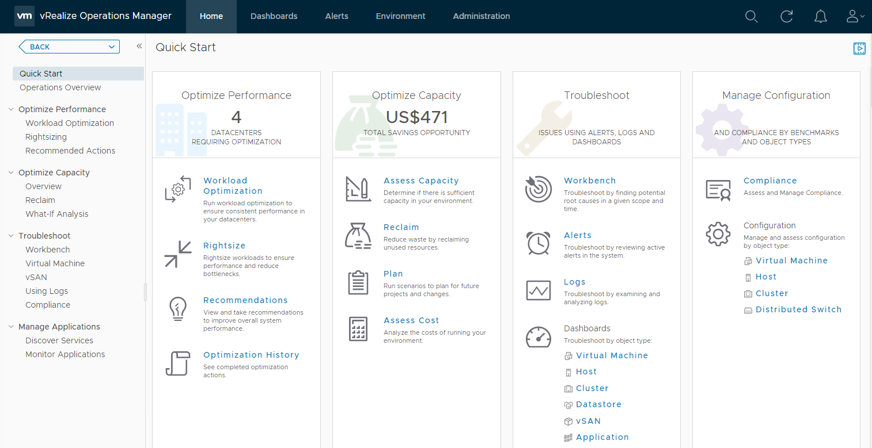
Troubleshooting
Troubleshooting Workbench for expediated root cause analysis
Line of sight from apps to Infra, including (cloud-exclusive) APM tool integration and near real-time monitoring
Simplified alert creation, dashboard mgmt, consistent navigation & summary pages
Metric Correlation (including logs-as-metrics and log/metric correlation) and Super Metrics workflows for faster troubleshooting
OOB application monitoring (20 total) via Telegraf agents and custom script execution
Native Service Discovery with support for top-n processes and one-time script execution
Custom Properties for enhanced process automation, reports, views

Slide 14
Compliance
Simplified Compliance Workflows
Regulatory and SDDC (vSphere, NSX-T, vSAN) compliance content
Monitor compliance for VMs in VMware Cloud on AWS
Ability to create Custom Compliance standards
Automated configuration management with OOTB workflows and vRO integration
Import/Export of custom compliance standards

Slide 15
Expanding Unmatched Operations
Reach beyond legacy datacenters

Slide 16
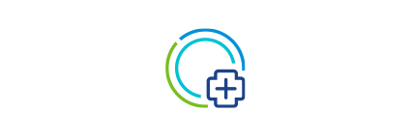
Open Ecosystem Integrations
Attain data depth & context in a single view, with relationship-aware integrations
CMDB
Apps
Collaborative Management
With the ability to aggregate operations data from the leading server, storage, compute and database applications, VMware Aria Opeations becomes single source of truth for multiple IT teams.
Native Public Cloud
Custom Integrations
End-to-end visibility
Provide value through a unified view, integrating data from your datacenter infrastructure and applications to create a cohesive monitoring strategy.
VMware Aria
Operations
VMware Aria Operations for:
Logs
Integration
Networks
Skyline
Physical Infrastructure
Relationship-Aware Monitoring
Quickly assess the state-of-affairs and gain a deeper understanding of how one piece of the stack might be affecting another.
Tanzu & Kubernetes
CloudHealth
Notes:
Over the years we’ve heard many customers ask if they can take this powerful operations platform and seamlessly connect it with any number of other technologies in their ecosystem. We have put extra emphasis on creating an open platform that can integrate and build a central point of information.

Slide 17

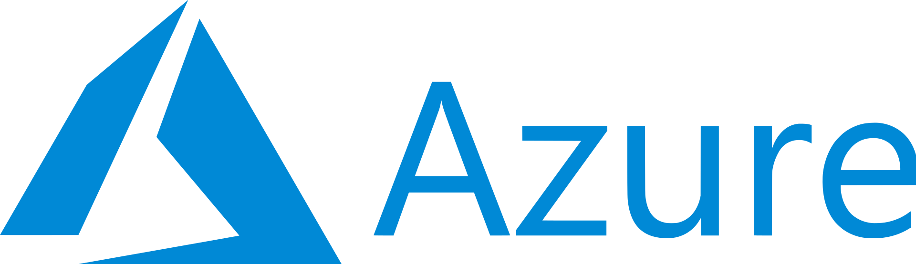
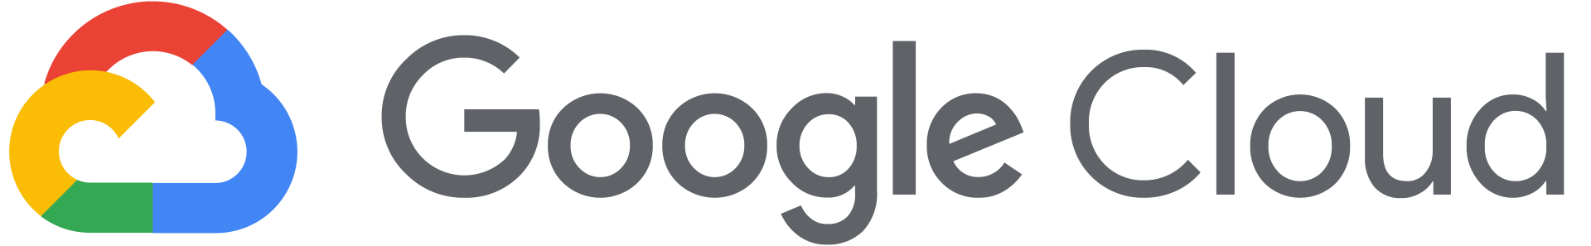
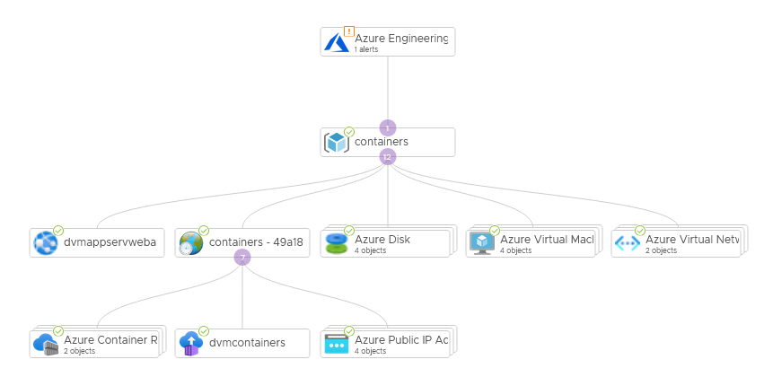
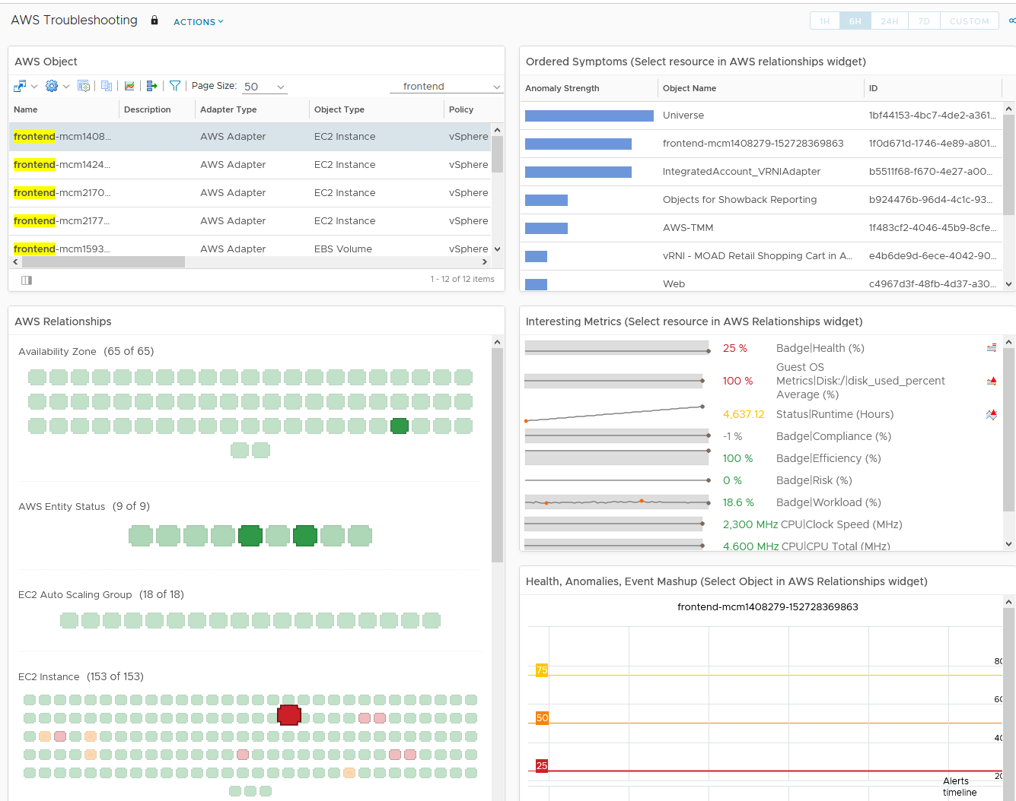
Monitor Public Clouds in VMware Aria Operations
Coverage for Most Popular Clouds and Services
Support for 68/110 services as of 8.6
99 object types
23 Dashboards
35 Alert Definitions
Support for 65/76 services as of 8.6
59 object types
11 Dashboards
14 Alert Definitions
Support for 14/57 services as of 8.6
10 object types
7 Dashboards
6 Alert Definitions
Notes:
VMware Aria Operations provides native monitoring for the two most popular hyperscalers – AWS and Azure. Customers simply configure a cloud account and VMware Aria Operations will find and monitor services, establish relationships, provide capacity forecasting for VMs and more.
For Google Cloud Platform, an optional management pack is available and offers coverage for some of the fundamental services.
Our goal is to cover all services for these hyperscalers and offer them natively, so keep up with every release as we intend to improve our public cloud coverage very rapidly.

Slide 18
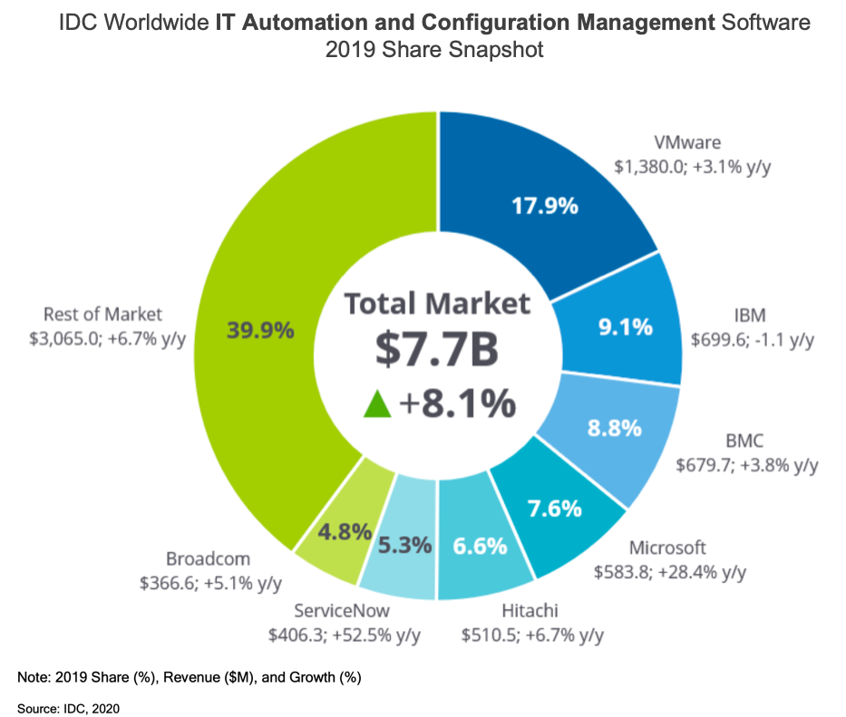
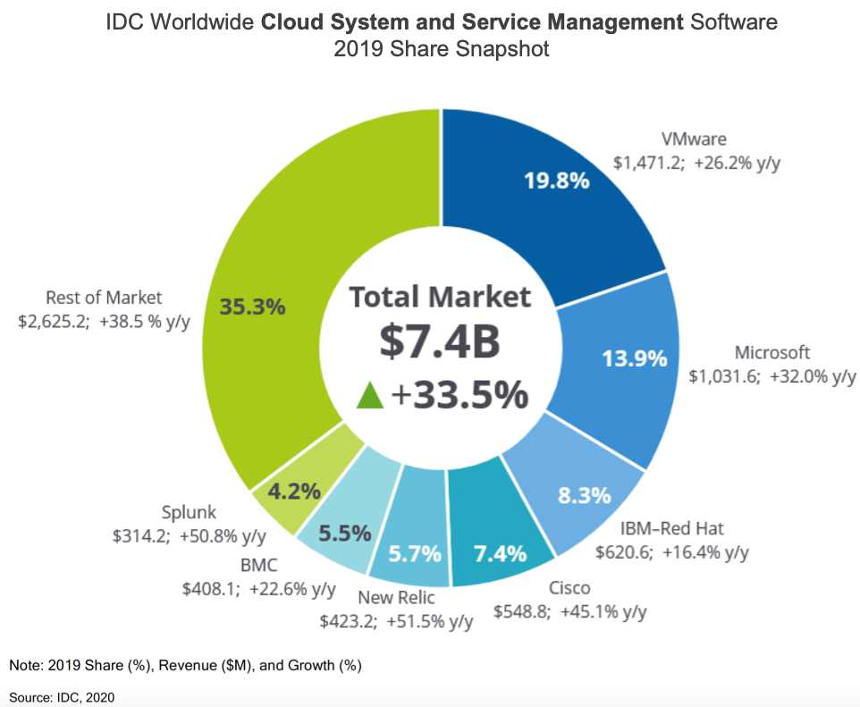
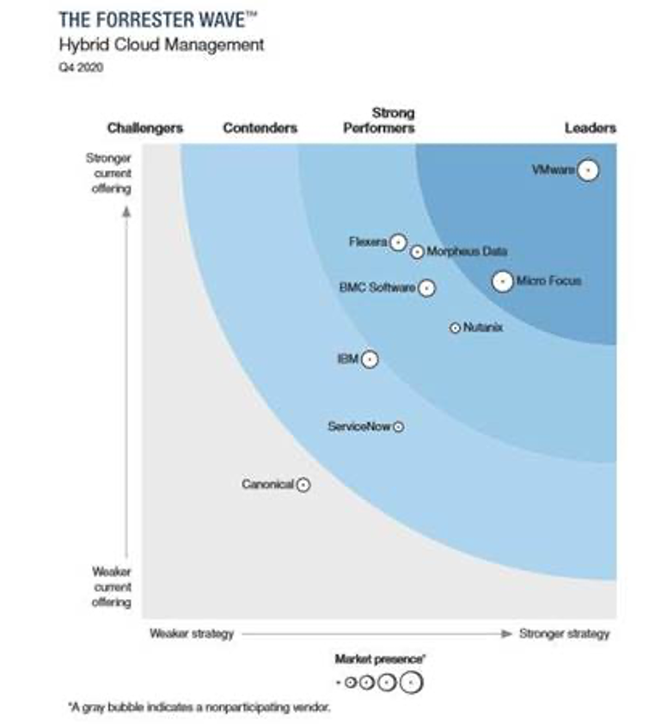
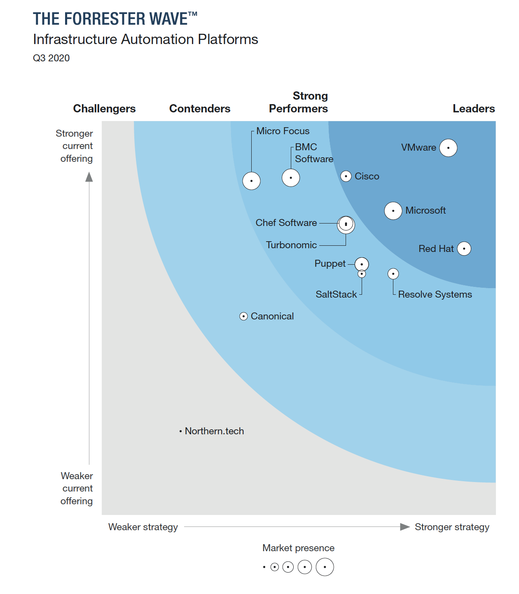
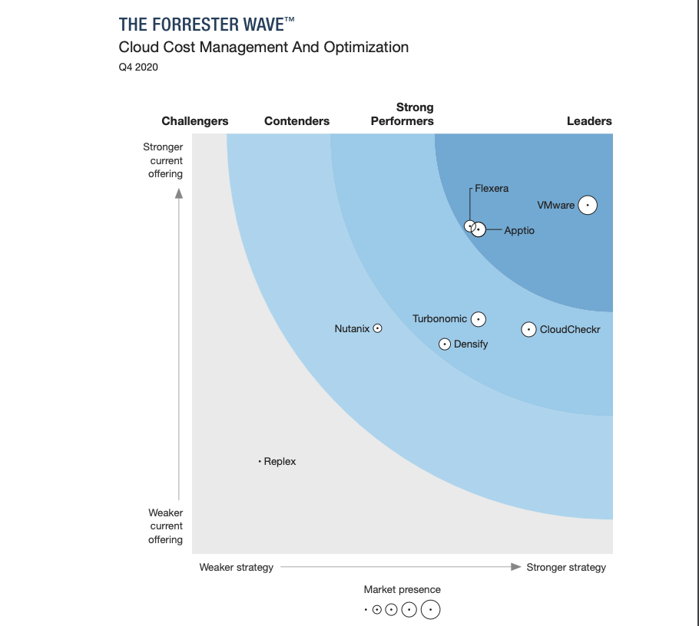
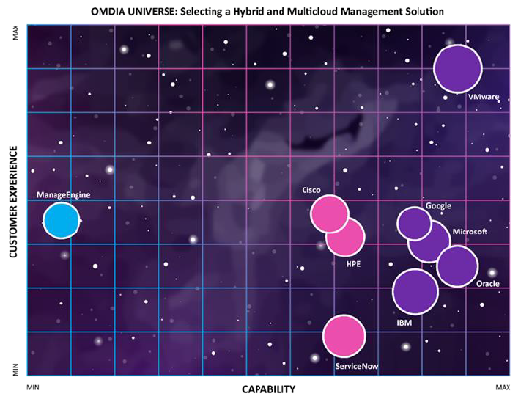
VMware Cloud Management Recognized by the Industry
#1 IDC Market Share
A LEADER in The Forrester Wave™
#1 OMDIA Universe
IDC IT Automation and Configuration Management Market Share
IDC WW Cloud Systems and Service Management Market Share
Forrester Hybrid Cloud Management Wave™
Forrester Infrastructure Automation Wave™
Forrester Cloud Cost Management and Optimization Wave™
OMDIA Selecting a Hybrid & Multicloud Management Solution
Source: IDC, Worldwide Cloud System and Service Management Software Market Shares, 2019: SaaS and ITOM Drive Growth, Doc #US45083420, May 2020Cloud Mgt Market Share
The Forrester WaveTM is copyrighted by Forrester Research, Inc. Forrester and Forrester WaveTM are trademarks of Forrester Research, Inc. The Forrester WaveTM is a graphical representation of Forrester’s call on a market and is plotted using a detailed spreadsheet with exposed scores, weightings, and comments. Forrester does not endorse any vendor, product, or service depicted in the Forrester WaveTM. Information is based on best available resources. Opinions reflect judgment at the time and are subject to change.
Forrester, Inc., The Forrester Wave™: Hybrid Cloud Management, Q4 2020, November 30, 2020
Forrester, Inc., The Forrester Wave™: Infrastructure Automation Platforms, Q3 2020, August 10, 2020
Forrester, Inc., The Forrester Wave™: Cloud Cost Management and Optimization, Q4 2020, October 28, 2020
Source: OMDIA Universe, Selecting a Hybrid and Multicloud Management Solution, 2020-2021Mgt Market Share
Source: IDC, Worldwide IT Automation and Configuration Management Software Market Shares, 2019: Market Expands Ahead of Coronavirus Impact, Doc# US46397520, June 2020
Notes:
VMware Aria cloud management is not only trusted by customers worldwide, but also recognized by industry analysts as #1 in market share by IDC, as a leader in the market by Forrester in these 3 Forrester Wave reports, and by OMDIA in the OMDIA Universe report.
Plus, VMware Aria was recognized by Gartner Peer Insights: Customers’ Choice Award: IT Infrastructure Monitoring Tools.
Transition: Let’s summarize this for you.

Slide 19
VMware Aria Operations works smoothly, without my influence. I get a message before an upgrade, then it happens automatically. A few minutes later, I get another saying everything is finished. I’m saving up to 10 hours a month on upgrades and troubleshooting. That’s success to me.”
—STEPHAN WIECHERT, IT SYSTEM SPECIALIST, BöRSE STUTTGART AG
Notes:
Borse Stuttgart – is the 2nd largest stock exchange in Germany.
In 2018 they were managing their financial data on-premises.
In 2019 the leader board (executive management team) switched to a cloud-first strategy.
Now putting as much as possible in the cloud, the IT team is shifting to being more of a service group to the organization versus a system maintenance “shop” of managing the systems. They are moving to an all-cloud strategy except maintaining a few local on-prem systems for trading data to meet regulatory requirements.
Why Borse Stuttgart liked SaaS management:
Compute and capacity management were primary goals
Monitoring & Visibility
Troubleshooting
With COVID-19, the traders cannot work from home, and they have to work from the trading floor. All other employees are working from home, and it’s important for IT to see the bandwidth. With VMware Aria Operations, the IT team can see the VMs, overall host CPU, overall host capacity.
With SaaS, what Stephan liked was that SaaS is helping him to:
Save up to 10-hours of time not having to do maintenance and upgrades
When asked what did you do with those 10-hours, he said he used the time to create dashboards and reports for his leader board to see what capacity they’re using to help plan for the next few months.

Slide 20
Looking for more?

Slide 21
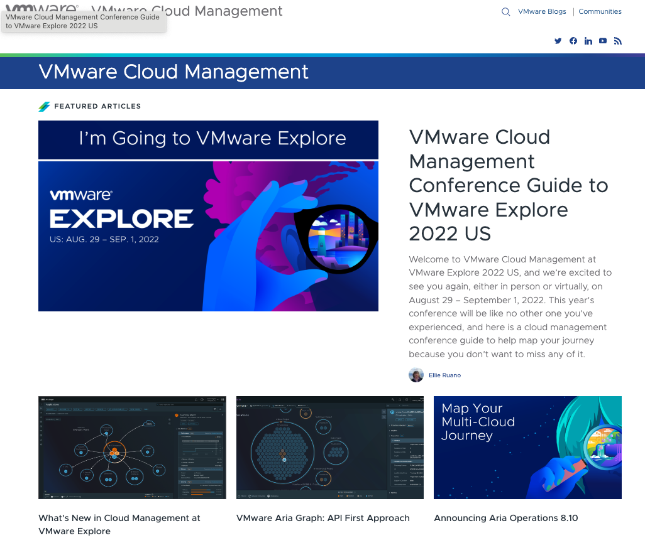
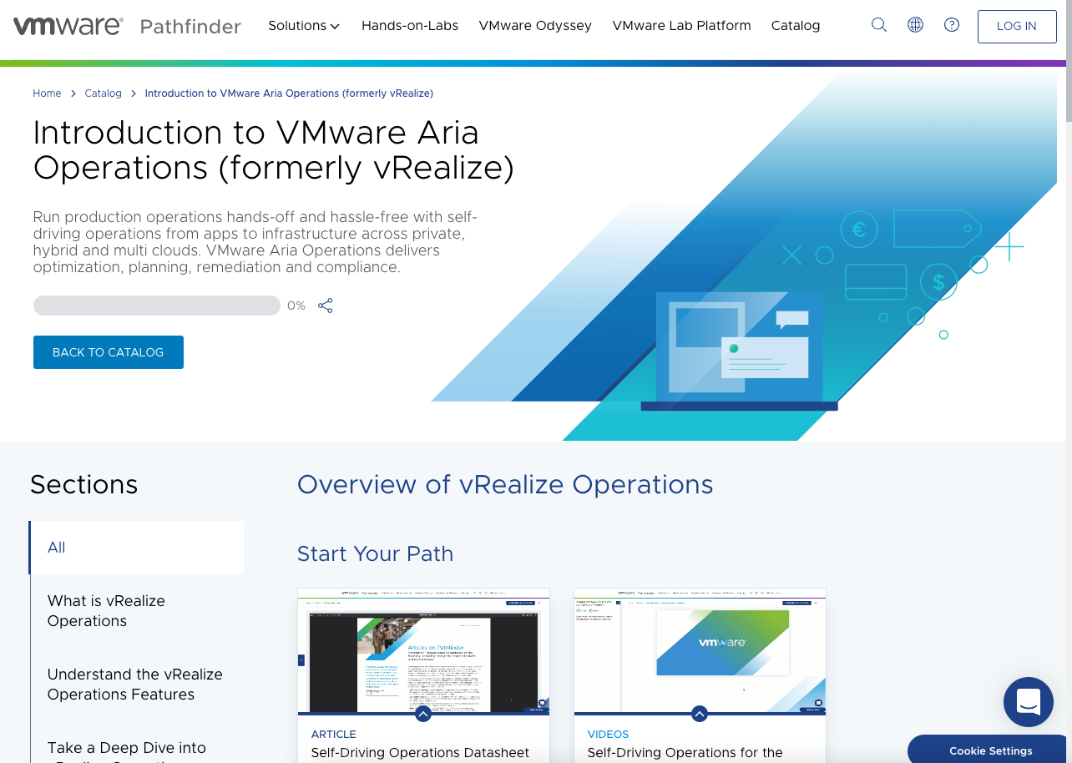
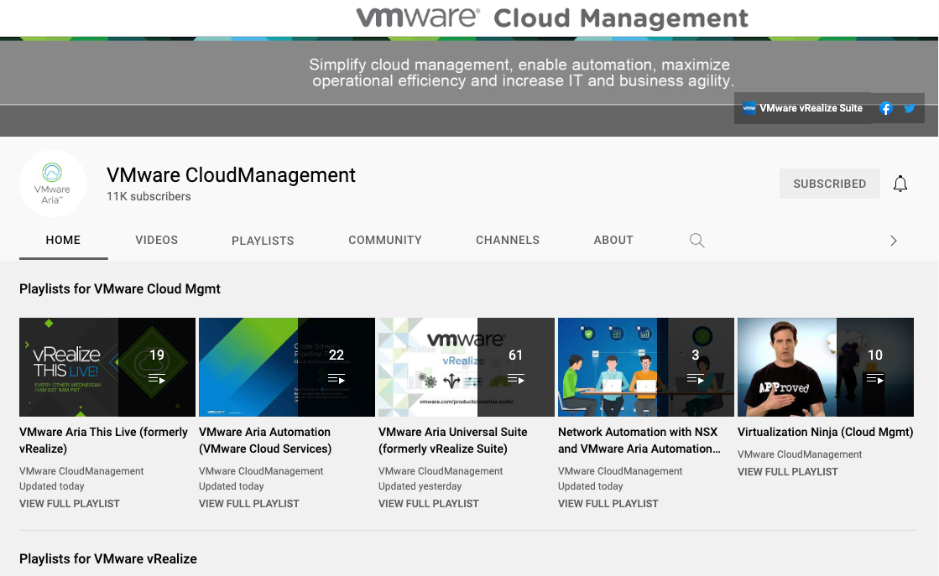
Learn More from Great Resources
Pathfinder
Technical content
What’s new blogs
Looking for materials that cover business use cases as well as technical guides?
Aria Operations Path
Dive deep with our technical experts and try the product hands on!
Aria Operations Hands on Labs
Cloud Management YouTube Channel
Read all about new upcoming product and feature releases.
VMware Cloud Management Blog

